Slide 1

Smart Notice Board
Under The Guidance Of
Prof. Alka Choksi
Developed By
Nilesh Sharma [200511202055]
Prince Singh [200511202056]
Submitted To:
Department of MCA
Faculty of IT & Computer Science,
PARUL University

Slide 2
INDEX
Project profile
Requirement Analysis
Design
Implementation
Testing
future Enhancement
Bibliography
Thanks you

Slide 3
Project Definition
The Online Notice Board which will make use of the modern communication method and techniques for information flow.
The aim of this project is to develop a wireless notice board that will be used at the faculty in order to display latest information.
The Smart Notice Board System is intended for colleges and institutions where information and file sharing on regular basis plays vital role in the performance.
The system is planned to consist of various useful features for the said purpose.
An Smart notice board is a place where people can leave any types of messages and notifications, for example, to advertise things, announce events or provide any information.

Slide 4
Project Description
Nowadays every advertisement is going to be digital. The moving message display is used in college campus, universities to scroll different events and important notice.
A Notice Board is a surface intended to convey important news, announce events or provide information
Aim to create this platform for issuing notice, sharing information and files between the members of the institution.
The administrator shall be able to issue notice, upload files and view students activities.

Slide 5
Existing System
The Existing System consist of paper based notice which has been carried by the human. Due to this reason, it has some disadvantages;
The paper file has to be stored in sorted form and manage them.
The searching is very difficult to view a particular paper.
Sometimes the notice paper may be damaged due to weather(eventually happens in rainy season).

Slide 6
Problem Statement
Now this digital world many people have access to modern technology. The wall notice board is outdated and has many limitation.
Examples :
It is hard to know latest posts.
You don’t have direct access to the people who post the notice.
Difficult to keep checking the notice board for new post.
It is not normally accessible with their limitation which around us the normal notice board .

Slide 7
Proposed System
The proposed system aims to create a platform for issuing notice, sharing information, admission forms details. Different users shall have different content.
Students can see general notice, personal notice, feedback(query or any other message) send to the administrator.
The administrator able to issue notice, upload files, view students activity, manage students, manage notice.
The guest will simply be able to view public or general notice.

Slide 8
Scope
We can provide SMS based integration for registration confirmation.
Send results through an email to registered students and updated notice by an admin.
It is the web-based application software that aims to aid the institutes by providing such digital notice board.

Slide 9
Tools & Technology
Front end: HTML, CSS, Jquery, Bootstrap
Middle end: PHP
Back end: MySQL ;

Slide 10
Justification:
The system will reduce energy and time spent checking the notice board.
User can responding to the post.
It will give user ability to filter notice or post according to the subject or particular topics.

Slide 11
Requirement Analysis : Feasibility Study
A feasibility analysis involves a detailed assessment of the need, value and practicality of a proposed enterprise, such as systems development.
The process of designing and implementing record keeping systems has significant accountability and resource implications for an organization.
Most feasibility studies are distinguished for both users and analysts
It is operationally, economically and technically realistic to proceed with a particular course of action.

Slide 12
Operational feasibility
People are inherently resistant to change, and computers have been known to facilitate change.
An estimate should be made of how strong a reaction the user staff is likely to have toward the development of a computerized system.
It is common knowledge that computer installations have something to do with turnover, transfers, retraining, and changes in employee job status

Slide 13
Technical feasibility
Technical feasibility centers around the existing computer system (hardware, software, etc.)
If the current computer is operating at 80 percent capacity – an arbitrary ceiling – then running another application could overload the system or require additional hardware.
This involves financial considerations to accommodate technical enhancements.

Slide 14
Module Used
Registration module
Login module
About Us module
Contact Us module
Ask me module

Slide 15
Users of the System
Admin
Teacher
Student
Guest/User

Slide 16
Admin:
Can add ,activate and deactivate any user
Add new notice and send notice to registered users
Display old notice and manage old notice
Update password

Slide 17
Teacher
Teacher Registration
Login
Check Notification sent by admin
Add new notice and send notice to registered Student
Update Profile
Update Password
Log out

Slide 18
Student
Student Registration
Login
Check Notification sent by admin
Update Profile
Update Password
Log out

Slide 19
Guest/User
Visit the Website
View all Notices

Slide 20
Software:
Front End-HTML,CSS, Jquery, Bootstrap
Middle End- PHP
Back End – MySqli
Server – Apache server
Design Tool – Sublime Text

Slide 21
Hardware:
233 MHz processor
128MB SD-RAM
2-4GB HARD-DISK.

Slide 22
Use Case Diagram
Login
Upload
Notice
Admin
Teacher
View Notice
Delect Notice
Give feedback
Guest/User
Student
Lgout

Slide 23
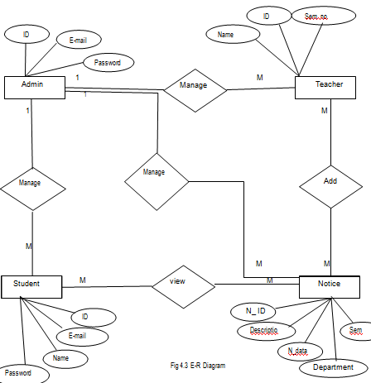
ER- Diagram

Slide 24
Data Dictionary: Admin
Name | Data type | Field Size | Description | Example
ID | Int | 11 | Unique number id for Admin | 1111
User | Varchar | 50 | User name to Admin | prince@123
Password | Varchar | 20 | Password for Security | *********

Slide 25
Teacher
Name | Data type | Field Size | Description | Example
ID | int | 11 | Unique number id for Teacher | 1010
Name | Varchar | 100 | Teacher name | Nilesh
Mob_no | Varchar | 12 | Teacher mobile number | 959554555
E-mail | Varchar | 100 | Teacher e mail | nilrsh@gmail
Branch | Varchar | 10 | Teacher Branch | MCA
Password | Varchar | 30 | Password for Security | ********
Img | Varchar | 200 | Store the data img

Slide 26
Student
Name | Data type | Field Size | Description | Example
S_no | Int | 11 | Unique number id for Student | 655
Name | Varchar | 100 | Name of Student | xyz
E-mail | Varchar | 100 | E-mail of student | xyz@
Subject | Varchar | 200 | Subject marks is dispaly | 875
Message | Varchar | 200 | Message will be connect | I am good

Slide 27
Notice
Name | Data type | Field Size | Description | Example
Notice_id | Int | 11 | Admin/Teacher will be given to All ID Notice to selected ID | All/784
Branch | Varchar | 100 | Notice will be given to all Branch As per selected branch | All/MCA
Sem | Varchar | 100 | We will give All sem to notice | All/3
Subject | Varchar | 100 | Notice of Exam subject | All
file | Varchar | 100 | Notice will be file | All
.

Slide 28
Feedback
Name | Data type | Field Size | Description | Example
S_no | Int | 11 | Feedback all ID member | 876
Name | Varchar | 100 | Name will be mension those is give Feedback | XYZ
E-mail | Varchar | 100 | E-mail will be mension those is give Feedback | XYZ@
Subject | Varchar | 200 | Feedback of Subject | Xyz is good
Message | Varchar | 200 | Any message | xyz
Datatime | Varchar | 50 | Date of feedback | 15/12/2021

Slide 29
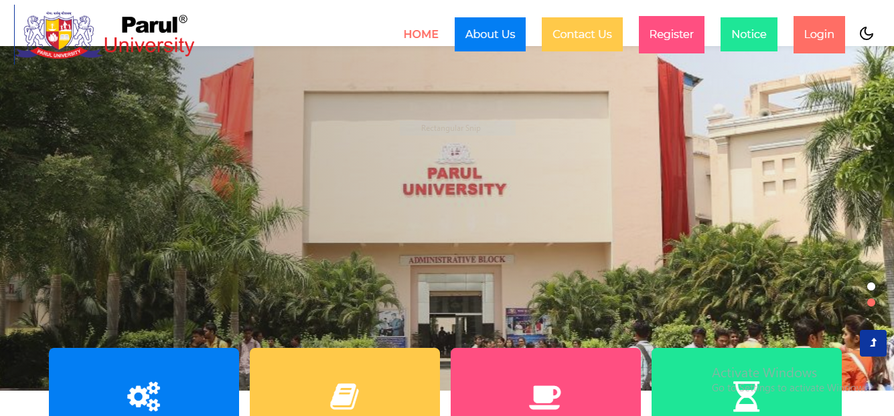
Home page

Slide 30
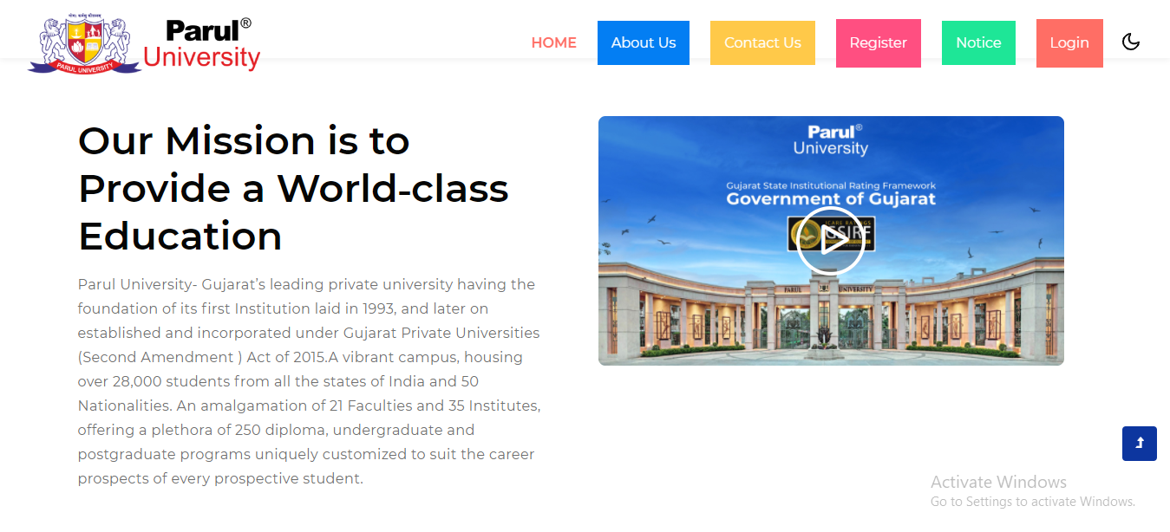
About

Slide 31
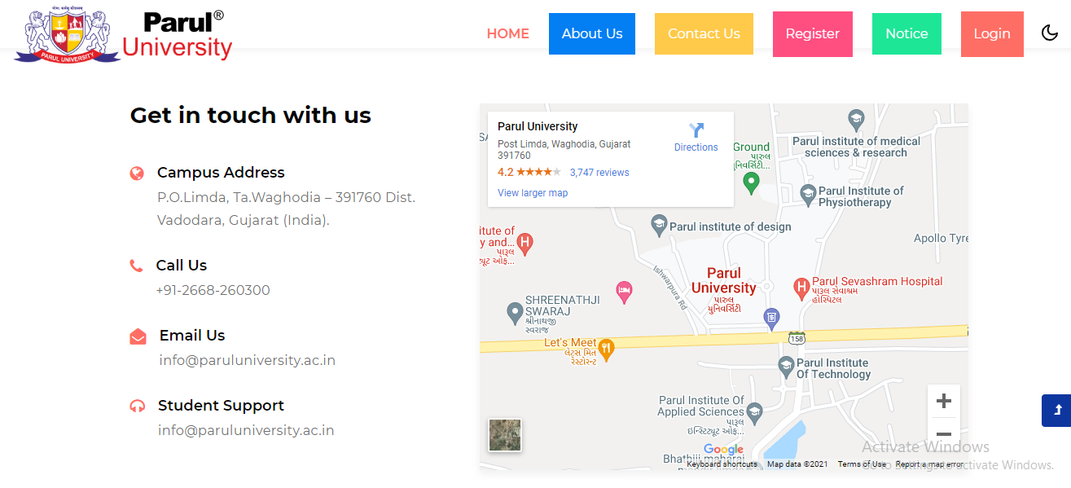
Contact us

Slide 32
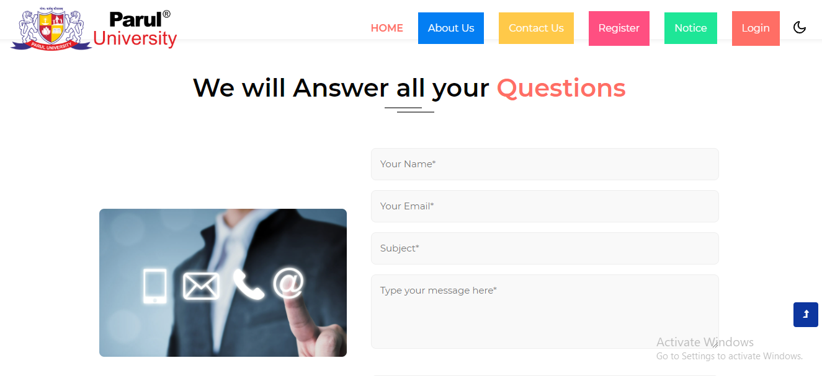
Feedback

Slide 33
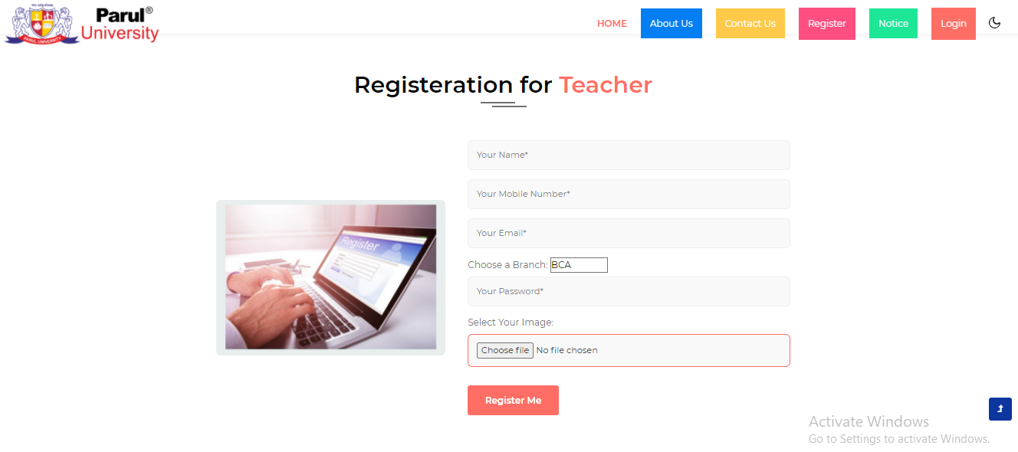
Registeration Teacher

Slide 34
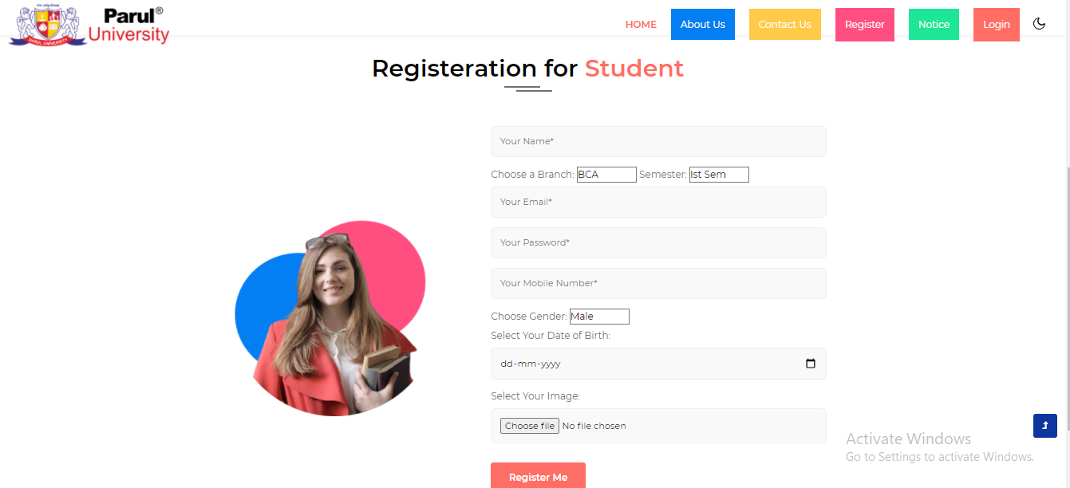
Registeration Student

Slide 35
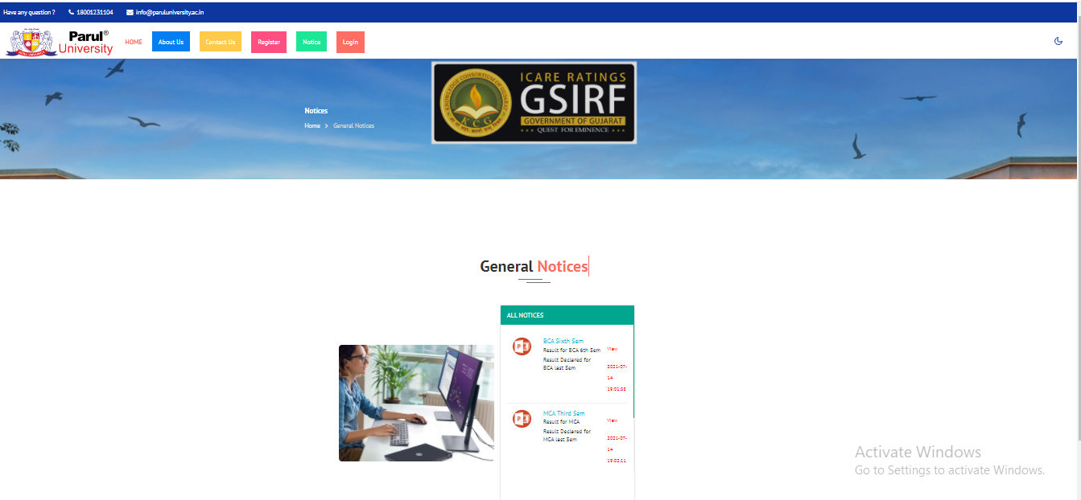
All Notice

Slide 36
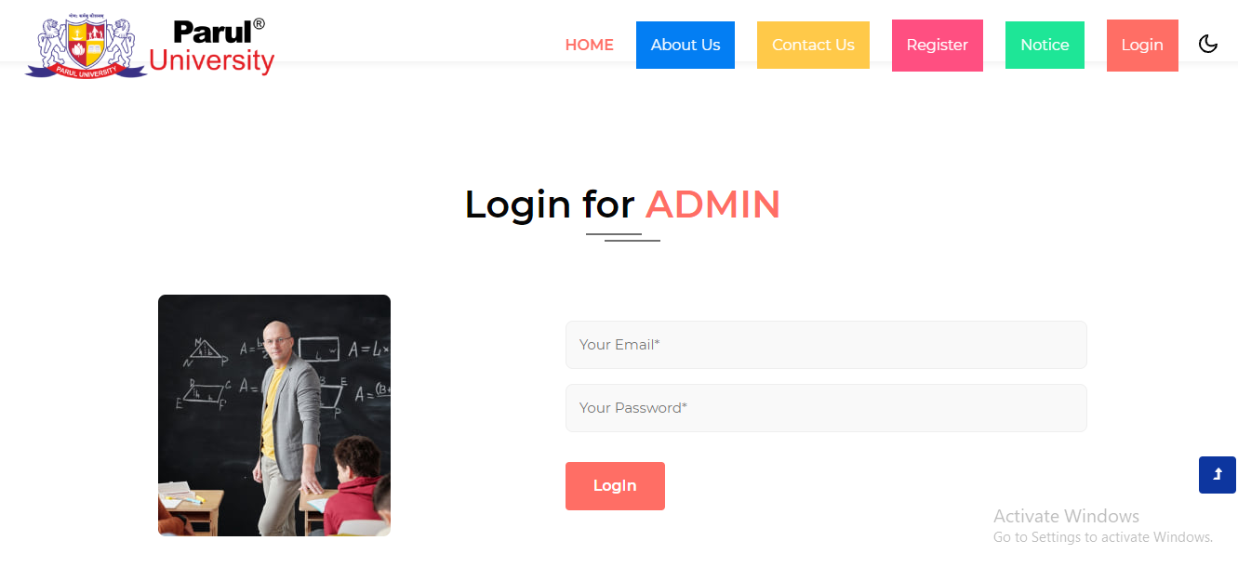
Login for Admin

Slide 37
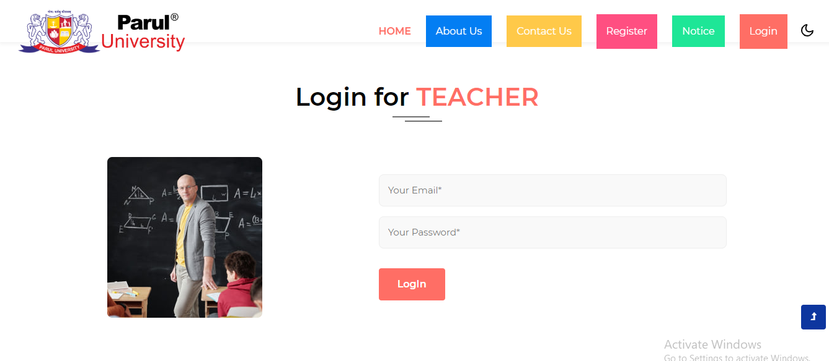
Login Teacher

Slide 38
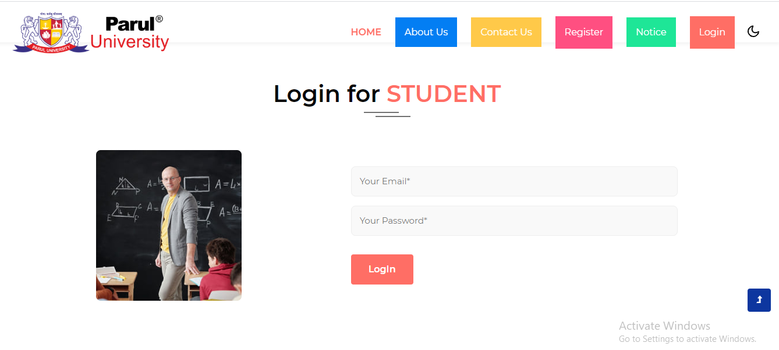
Login Student

Slide 39
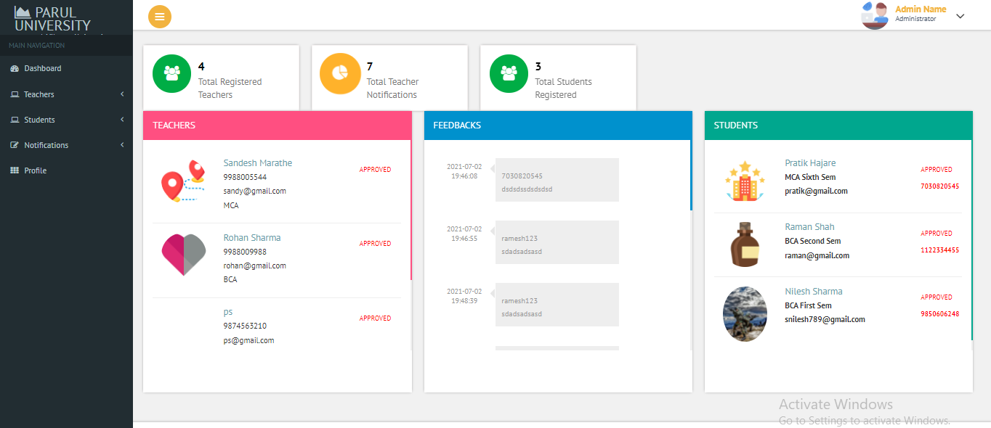
Admin profile

Slide 40
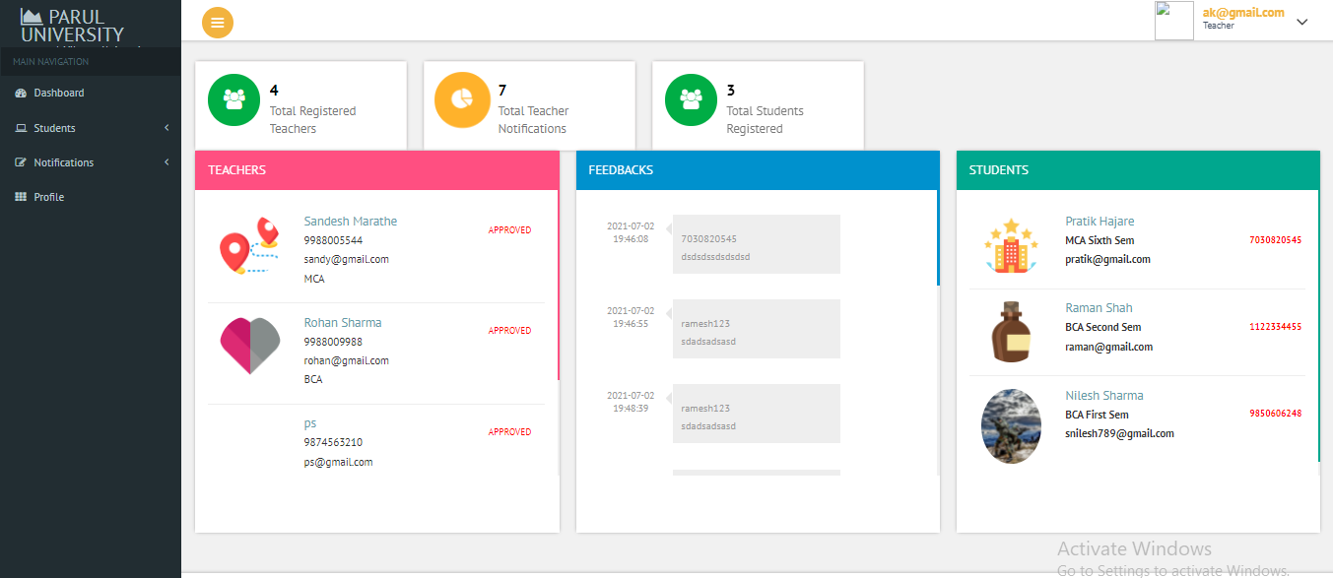
Teacher profile

Slide 41
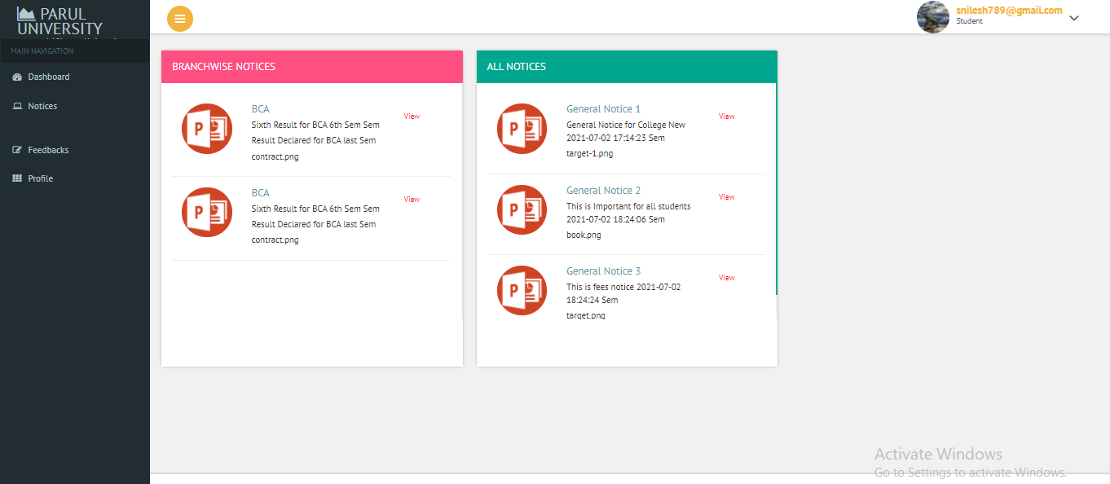
Student Profile

Slide 42
Testing Test Strategy
In our scenario, testing strategy is used to test the functionality of our system. We have to use to cover all scenario. Main focus is on Functional Testing. In Functional Testing test case are used to test the application interface.
In our system, testing is going to be done at individual (Unit) module level. Each module will be undergone to Unit testing (One Module) and expected result is supposed to be same as actual result

Slide 43
Admin Login
Test Case Summary | This test case was conducted for checking login.
Prerequisite | Admin must be registered in system.
Test Procedure | Enter email and password. Check the email and password is correct or not. Admin change status
Test Data | Email:ps@gmail.com Password: ****
Expected Result | Admin enters into the system
Actual Result | Admin can view the all Dashboard.
Status | Pass
Remark | This test case is for login into the system.
Test Environment | Chrome Browser

Slide 44
Teacher Login
Test Case Summary | This test case was conducted for checking login.
Prerequisite | Teacher must be registered in system.
Test Procedure | Enter email and password. Check the email and password is correct or not. Click on login button.
Test Data | Email:Teacher@gmail.com Password: ****
Expected Result | Teacher enters into the system
Actual Result | Teacher can view the all Dashboard.
Status | Pass
Remark | This test case is for login into the system.
Test Environment | Chrome Browser

Slide 45
Student Login
Test Case Summary | This test case was conducted for checking login.
Prerequisite | Student must be registered in system.
Test Procedure | Enter email and password. Check the email and password is correct or not. Click on login button.
Test Data | Email:ps@gmail.com Password: ****
Expected Result | Admin enters into the system
Actual Result | resisteration will be approved
Status | Pass
Remark | This test case is for login into the system.
Test Environment | Chrome Browser

Slide 46
Registeration
Test Case Summary | This test case was resisteration of teacher student
Prerequisite | All member must be registered in system.
Test Procedure | Fill registeration form Click on registeration button. After registeration get email and password
Test Data | Email:ps@gmail.com Password: ****
Expected Result | Admin enters into the system
Actual Result | Admin can view the all Dashboard.
Status | Pass
Remark | This test case is for login into the system.
Test Environment | Chrome Browser

Slide 47
Add Notice
Test Case Summary | This test case use for add notices admin the notice
Prerequisite | Admin add the notice
Test Procedure | Click add new notice or update notice or enterdata Click on update
Actual Result | Notice Add Successfully
Status | pass

Slide 48
future Enhancement :
This website which will be useful for students, teachers and other users to get notice and information
and also ask questions or send any feedback directly to the admin.
In future, we wish to implement the following ideas-
1. We can provide sms and email based integration for registration confirmation
2. Send results as an email to registered students and send sms alerts whenever results are sent to email or updated. Alerting module can be worked out in future.
3. We need to introduce a compression tool for the images in the database so that the wesite speeds up.
4. We will be improving the theme of the website to give a more classy and attractive look.

Slide 49
Bibliography:
www.github.com
https://www.phptpoint.com/
https://www.beingstudy.com/

Slide 50
THANK YOU

